Slide 1
SCANS IN MongoDB

Slide 2
Types of Scan
COLLSCAN
Scans the each document in the collection for processing query
COLLSCAN for a collection scan
IXSCAN
Process the queries based on the indexes and scans the indexes for results
IXSCAN for scanning index keys

Slide 3
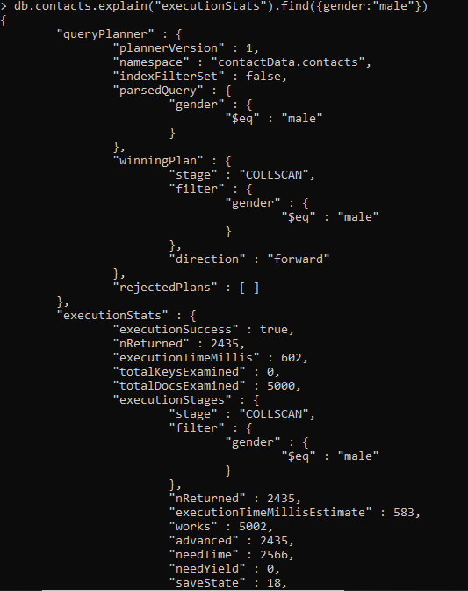
COLLSCAN

Slide 4
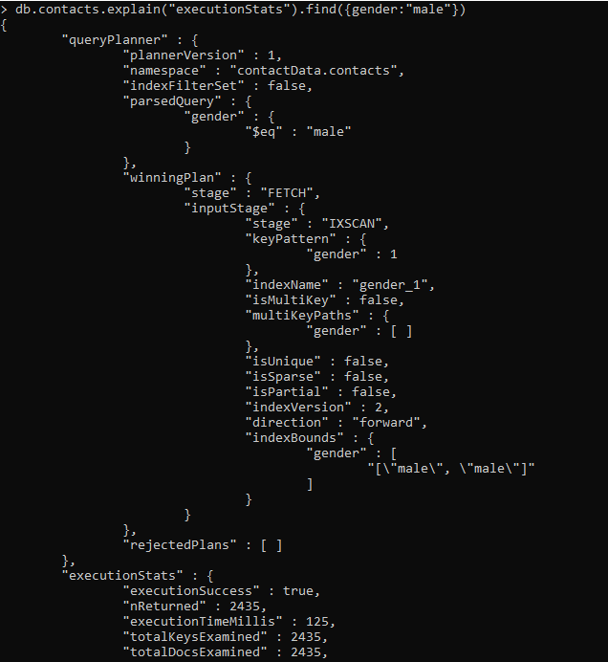
IXSCAN

